Slide 1
Unit - 5
Code Generation and Optimization(9 Hours)
Issues in the Design of a code generator – Basic Blocks and Flow graphs – Design of a simple Code Generator – Optimal Code Generation for Expressions–Principal Sources of Optimization – Peep-hole optimization – DAG- Optimization of Basic Blocks – Global Data Flow Analysis – Efficient Data Flow Algorithm – Recent trends in Compiler Design

Slide 2

Code generator converts the intermediate representation of source code into a form that can be readily executed by the machine.
A code generator is expected to generate the correct code.
Designing of code generator should be done in such a way so that it can be easily implemented, tested and maintained.

Slide 3

Code generator main tasks:
Instruction selection
Register allocation and assignment
Instruction ordering
Front end
Code optimizer
Code Generator
Target code
Mrs.T.Kujani, Dept. of CSE, Vel Tech

Slide 4
Issues in the design of a code generator
1. Input to code generator
The input to code generator is the intermediate code generated by the front end, along with information in the symbol table that determines the run-time addresses of the data-objects denoted by the names in the intermediate representation.
The issue is whether the input gives the code generator enough information to produce correct target code
For example, for t1 = a + b, the generator must know whether a and b are integers or floating-point values to choose the appropriate addition instruction. It also needs their storage locations to load their values.

Slide 5
Issues in the design of a code generator (contd)
2. Target program
The target program is the output of the code generator. The output may be absolute machine language, relocatable machine language, assembly language.
Thus, the choice affects code-generation effort and the steps needed before execution.

Slide 6
Issues in the design of a code generator (contd)
2. Target program (contd)
  Absolute machine language as output has advantages that it can be placed in a fixed memory location and can be immediately executed.
  Relocatable machine language as an output allows subprograms and subroutines to be compiled separately. Relocatable object modules can be linked together and loaded by linking loader.
  Assembly language as output makes the code generation easier. We can generate symbolic instructions and use macro-facilities of assembler in generating code.

Slide 7
Issues in the design of a code generator (contd)
3. Memory Management
The issue in memory management is deciding where each data object will be stored and how to access it during execution.
The code generator must determine:
Where to store variables and temporary results.
How much space each object requires.
How to access objects using their addresses or offsets.
For example, in t1 = a + b, it must generate instructions to load a and b from their storage locations and store the result in the location assigned to t1.

Slide 8
Issues in the design of a code generator (contd)
4. Instruction selection
Selecting the best instructions will improve the efficiency of the program.
It includes the instructions that should be complete and uniform.
Instruction speeds and machine idioms also plays a major role when efficiency is considered.
For example, the respective three-address statements would be translated into the latter code sequence as shown below:
P:=Q+R
S:=P+T
MOV Q, R0
ADD R, R0
MOV R0, P
MOV P, R0
ADD T, R0
MOV R0, S

Slide 9
Issues in the design of a code generator (contd)
5.Register allocation issues
Use of registers make the computations faster in comparison to that of memory, so efficient utilization of registers is important.
The use of registers are subdivided into two subproblems:
During Register allocation – we select only those registers which are available to store the value of a variable.
During a subsequent Register assignment phase, the specific register is picked to access the variable.
t1 = a + b
t2 = t1 * c
Keeping t1 in a register lets the next instruction use it immediately, avoiding a memory store and reload.
Poor register allocation causes extra memory accesses and slows down the target program.

Slide 10
Issues in the design of a code generator (contd)
6. Evaluation order
The code generator decides the order in which the instruction will be executed.
The order of computations affects the efficiency of the target code.
Among many computational orders, some will require only fewer registers to hold the intermediate results.

Slide 11
Issues in the design of a code generator (contd)
7. Approaches to code generation issues:
Code generator must always generate the correct code. It is essential because of the number of special cases that a code generator might face.
Some of the design goals of code generator are:
Correct
Easily maintainable
Testable
Efficient
Quick code must be generated

Slide 12
    Role of Code Generator
From IR to target program.
Must preserve the semantics of the source program.
– Meaning intended by the programmer in the original source program should carry forward in each compilation stage until code-generation.
Target code should be of high quality
– execution time or space or energy or …
Code generator itself should run efficiently
  instruction selection, register allocation and instruction ordering.

Slide 13
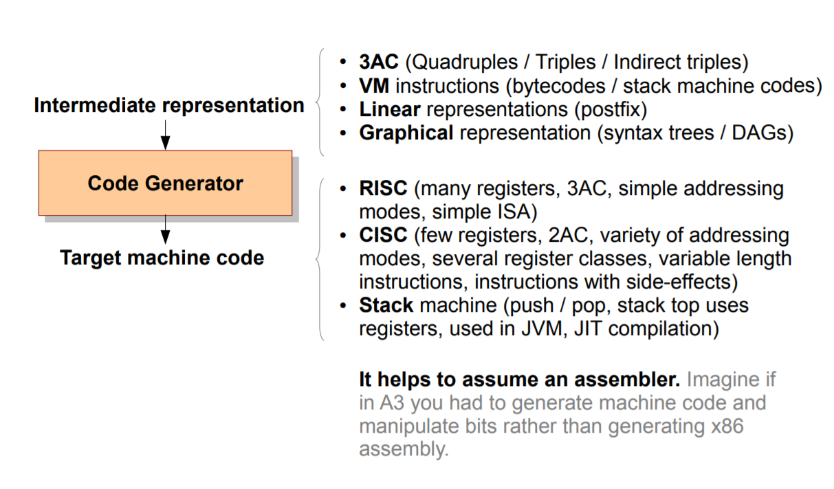
    Input + Output

Slide 14
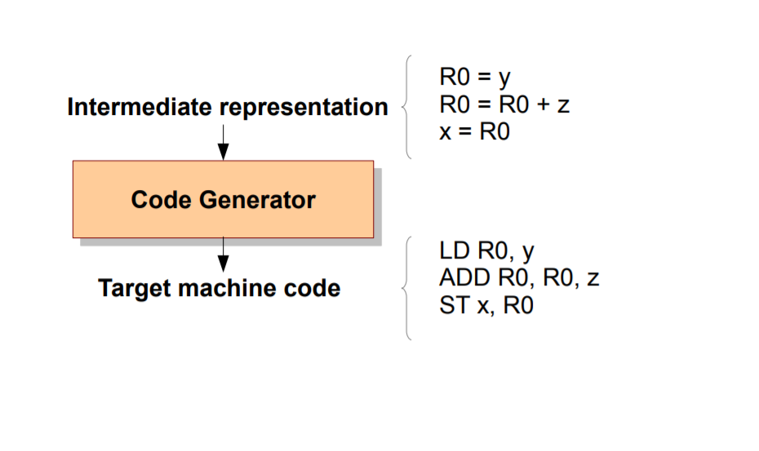
    IR and Target Code

Slide 15
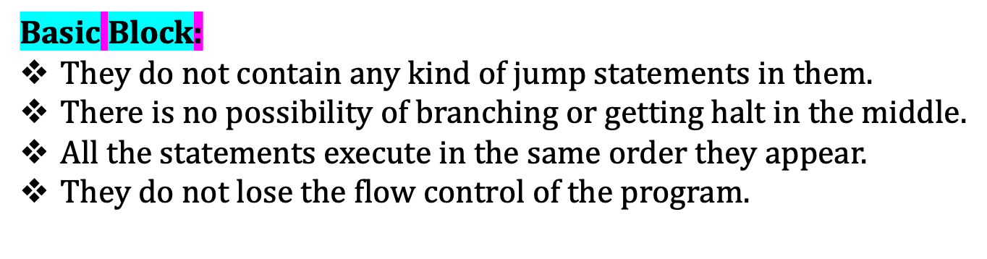
    Basic Blocks and Flow Graphs

Slide 16
    Basic Blocks (contd)
Example:
Three Address Code for the expression a = b + c + d is-
T1=b+c
T2=T1+d
A=T2

Slide 17
    Partitioning Intermediate Code Into Basic Blocks-
Basic Block Construction:
Algorithm: Partition into basic blocks
Input: A sequence of three-address statements
Output: A list of basic blocks with each three-address statement in exactly one block Method:
1. We first determine the set of leaders, the first statements of basic blocks. The rules we use are of the following:
a. The first statement is a leader.
b. Any statement that is the target of a conditional or unconditional goto is a leader.
c. Any statement that immediately follows a goto or conditional goto statement is a leader.
2. For each leader, its basic block consists of the leader and all statements up to but not including the next leader or the end of the program.

Slide 18
    Partitioning Intermediate Code Into Basic Blocks- (contd)
Rule-01: Determining Leaders
Rule-02: Determining Basic Blocks
Rule-01: Determining Leaders
Following statements of the code are called as Leaders–
First statement of the code.
Statement that is a target of the conditional or unconditional goto statement.
Statement that appears immediately after a goto statement.
Rule-02: Determining Basic Blocks
All the statements that follow the leader (including the leader) till the next leader appears form one basic block.
The first statement of the code is called as the first leader.
The block containing the first leader is called as Initial block.

Slide 19
    Basic Blocks- Practice Problems
Compute the basic blocks for the given three address statements-
(1) PROD = 0
(2) I = 1
(3) T2 = addr(A) – 4
(4) T4 = addr(B) – 4
(5) T1 = 4 x I
(6) T3 = T2[T1]
(7) T5 = T4[T1]
(8) T6 = T3 x T5
(9) PROD = PROD + T6
(10) I = I + 1
(11) IF I <=20 GOTO (5)

Slide 20
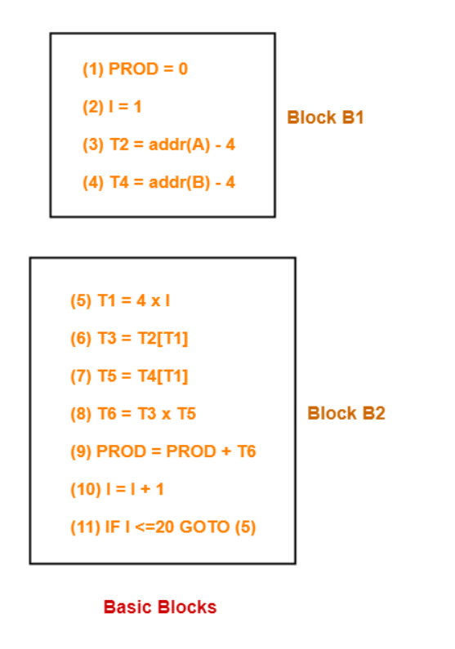
    Basic Blocks- Practice Problems (contd)
Solution:
We have-
PROD = 0 is a leader since first statement of the code is a leader.
T1 = 4 x I is a leader since target of the conditional goto statement is a leader.
Now, the given code can be partitioned into two basic blocks as-

Slide 21
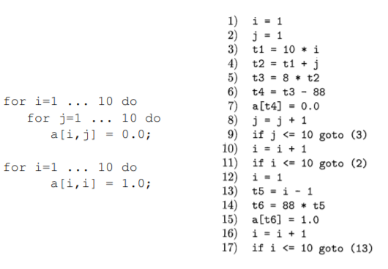
    Basic Blocks- Practice Problems(contd)
2. Compute the basic blocks for the given three address statements-

Slide 22
    Basic Blocks- Practice Problems(contd)
3. Compute the basic blocks for Intermediate code to set a 10*10 matrix to an identity matrix:
1) i=1 //Leader 1 (First statement)
2) j=1 //Leader 2 (Target of 11th statement)
3) t1 = 10 * i //Leader 3 (Target of 9th statement)
4) t2 = t1 + j
5) t3 = 8 * t2
6) t4 = t3 - 88
7) a[t4] = 0.0
8) j = j + 1
9) if j <= goto (3)
10) i = i + 1 //Leader 4 (Immediately following Conditional goto statement)
11) if i <= 10 goto (2)
12) i = 1 //Leader 5 (Immediately following Conditional goto statement)
13) t5 = i - 1 //Leader 6 (Target of 17th statement)
14) t6 = 88 * t5
15) a[t6] = 1.0
16) i = i + 1
17) if i <= 10 goto (13)
There are 6 Baic Blocks in the above code :
B1) Statement 1
B2) Statement 2
B3) Statement 3-9
B4) Statement 10-11
B5) Statement 12
B6) Statement 13-17

Slide 23
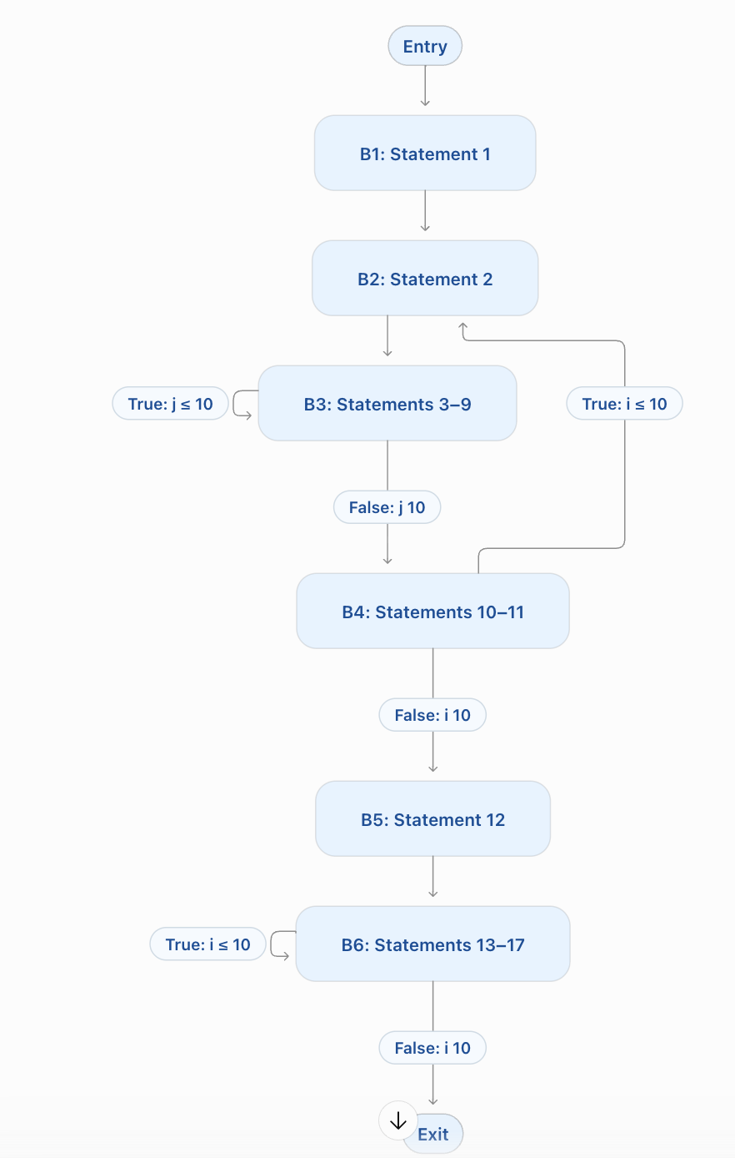

Slide 24
    Flow Graphs
A flow graph, also called a control-flow graph (CFG), is a directed graph that represents the possible flow of execution between basic blocks in a program.
A basic block is a sequence of consecutive instructions with one entry point and one exit point.
In a flow graph:
Nodes represent basic blocks.
Directed edges represent possible transfers of control.
The entry block is the block where execution begins.
An edge is drawn from block B1 to block B2 when B1 can jump to B2, or when execution can continue directly from B1 to B2.

Slide 25
    Flow Graphs
1. i = 1
2. sum = 0
3. if i > 5 goto 8
4. t1 = i * i
5. sum = sum + t1
6. i = i + 1
7. goto 3
8. print sum
The leaders are 1, 3, 4 and 8. They form the following basic blocks:
Block | Instructions | Purpose
B1 | 1–2 | Initialize i and sum.
B2 | 3 | Check the loop condition.
B3 | 4–7 | Add the square of i, increment i, and return to the condition.
B4 | 8 | Print the result.

Slide 26
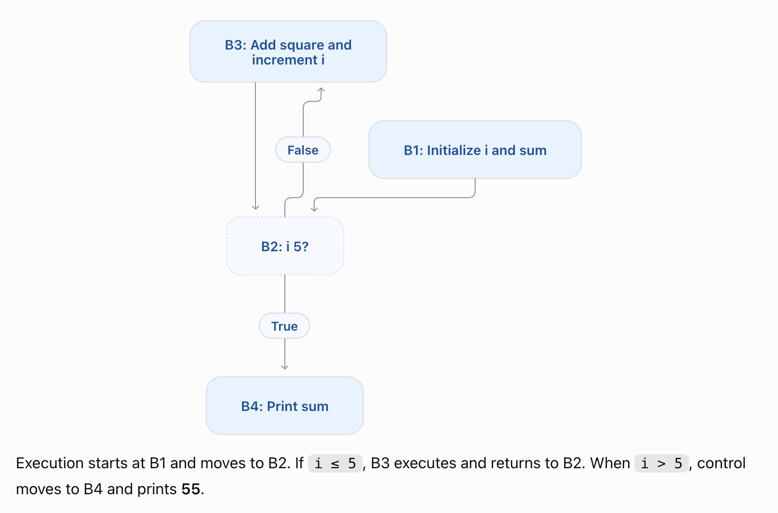
    Flow Graphs
1. i = 1
2. sum = 0
3. if i > 5 goto 8
4. t1 = i * i
5. sum = sum + t1
6. i = i + 1
7. goto 3
8. print sum
The leaders are 1, 3, 4 and
8. They form the following basic blocks:

Slide 27
    A Simple Code Generator
A code generator translates intermediate code into target instructions.
Input: three-address statements and symbol-table information.
Output: assembly instructions or machine code for the target computer.
A simple generator processes one basic block at a time.
Goal: generate correct code while reducing unnecessary loads and stores.
1
Notes:
Student exam notes. Target model uses two-address instructions in source, destination order. Register reuse requires safe overwriting and preservation of live values.

Slide 28
    A Simple Code Generator
• For example: consider the three-address statement a := b+c It can have the following sequence of codes:
ADD Rj, Ri Cost = 1 (Rj and Ri are mapped to b and c)
(or)
ADD c, Ri Cost = 2
(or)
MOV c, Rj ; Load c into Rj
ADD Rj, Ri ; Ri = Ri + Rj
Cost = 3 units (extra move + add).

Slide 29
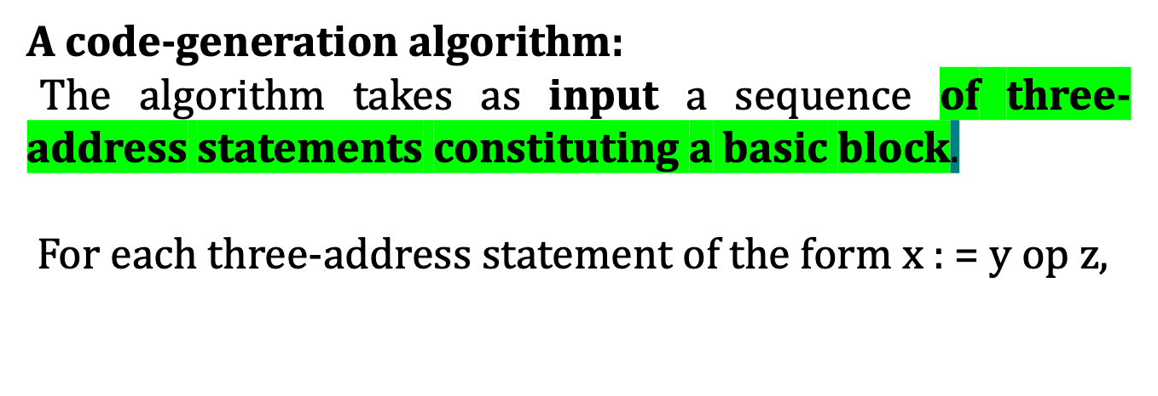
    A Simple Code Generator (contd)
Decide where the result should go (getreg).
Make sure operand y is in the right place.
Generate the actual operation using z.
Update descriptors and free registers when values are no longer needed.
This systematic approach ensures:Fewer MOV instructions,Efficient register usage,Correct mapping of variables to registers/memory

Slide 30
Step 1: Choose a Register
Example: t1 = a + b, followed by c = t1 * d
Assume a = 5, b = 3 and d = 2.
R1 is a small working space inside the processor.
getReg() chooses a register to hold the calculation result.
R1 is free, so the generator chooses L = R1.
L means the selected location. Here, that location is R1.
1
Notes:
The generator chooses the working location before loading operands. This example uses a simplified two-address target machine with source, destination instruction order. Numeric values illustrate execution.

Slide 31
Step 2: Load the First Value
a = 5 is in memory. R1 does not contain a yet.
Generate: MOV a, R1
This instruction copies the value of a into R1.
After execution: R1 contains 5. Memory a still contains 5.
2
Notes:
MOV copies the value and leaves the source unchanged. In the general algorithm, y is the first operand and y prime identifies a location containing its current value. Here y is a and its selected location is memory a.

Slide 32
Step 3: Perform the Operation
R1 contains the first value, a = 5.
Generate: ADD b, R1
This means: R1 = R1 + b.
After execution: R1 = 5 + 3 = 8.
The value 8 in R1 now represents the result t1.
3
Notes:
Our target model permits a memory source operand and a register destination. The addition overwrites the old contents of R1. Other target machines may require loading the second operand into a register as well.

Slide 33
Step 4: Update the Records
After the addition, R1 contains t1 = 8.
Register descriptor: record that R1 holds t1.
Address descriptor: record that t1 is available in R1.
Remove R1 from the locations of a. Memory still holds a = 5.
These records help the generator find values for later statements.
4
Notes:
A register descriptor lists the values represented by register contents. An address descriptor lists valid locations of a variable’s current value. Descriptors must be updated after every instruction that changes the register contents.

Slide 34
Step 5: Keep and Save Needed Values
The next statement is c = t1 * d, so keep t1 in R1.
Generate MUL d, R1. Execution gives R1 = 8 * 2 = 16.
Assume t1 has no later use. R1 can now hold c instead.
Update the records: R1 holds c, and c is available in R1.
Later code needs c. At block exit, generate MOV R1, c.
Memory c becomes 16. R1 remains 16. Record c in both locations.
5
Notes:
Steps 1 to 4 repeat for the second intermediate statement. The multiplication reuses R1 because t1 is no longer needed after that operation, including outside the block. Step 5 preserves live values and stores required results whose memory copies are outdated. After the final MOV, c is available in memory and R1.

Slide 35
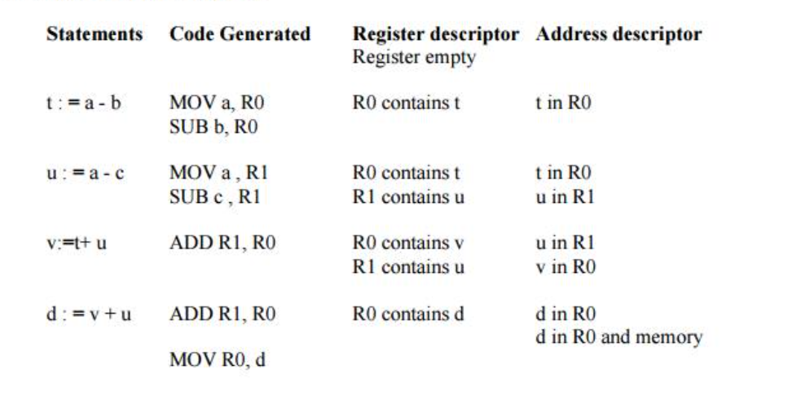
    A Simple Code Generator (Example)
Generating Code for Assignment Statements:
The assignment d : = (a-b) + (a-c) + (a-c) might be translated into the following three-address code sequence:
Code sequence for the example is:
t:=a-b
u:=a-c
v:=t+u
d:=v+u

Slide 36
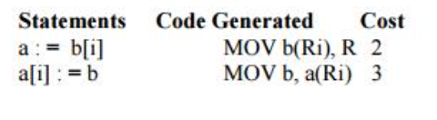
    A Simple Code Generator (Example)
Generating Code for Indexed Assignments
The table shows the code sequences generated for the indexed assignment
a:= b[ i ] and a[ i ]:= b

Slide 37
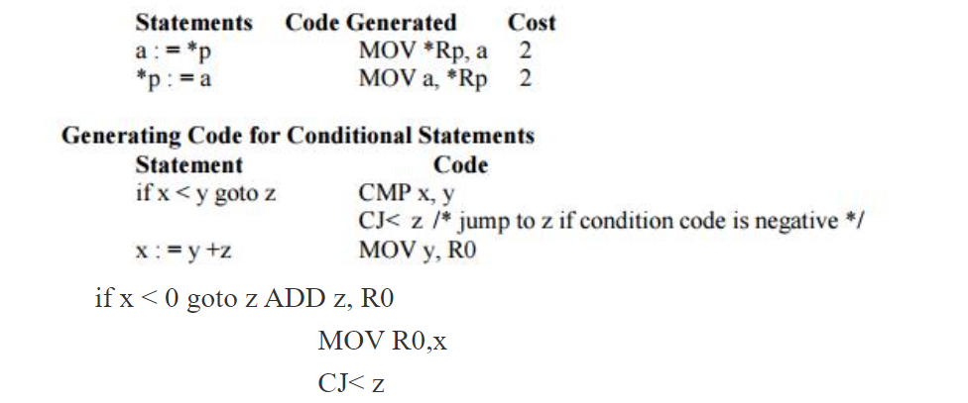
    A Simple Code Generator (Example)
Generating Code for Pointer Assignments
The table shows the code sequences generated for the pointer assignments a : = *p and *p : = a

Slide 38



Slide 39
Common Sub expressions elimination
Frequently a program will include calculations of the same value
• For example
t1: = 4*i
t2: = a [t1]
t3: = 4*j
t4: = 4*i
t5: = n
t6: = b [t4] +t5
This code can be optimized using the common sub-expression elimination as
t1: = 4*i
t2: = a [t1]
t3: = 4*j
t5: = n
t6: = b [t1] +t5
The common sub expression t4: =4*i is eliminated as its computation is already in t1
and the value of I
is not been changed from definition to use.

Slide 40
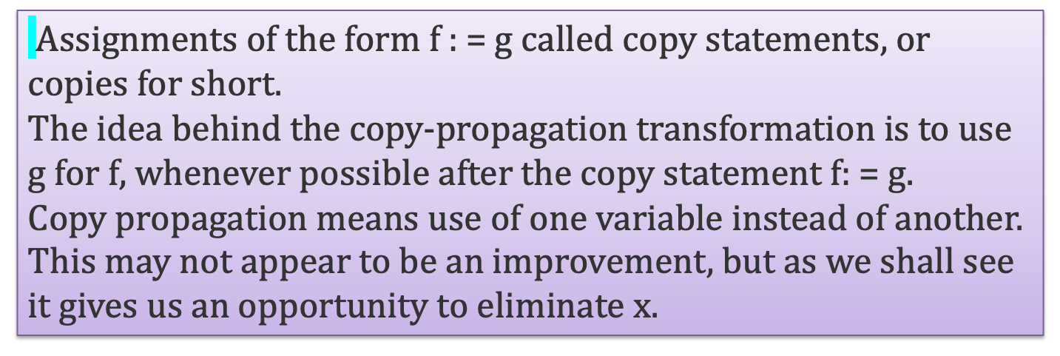
Copy Propagation
• For example:
x=Pi;
A=x*r*r;
The optimization using copy propagation can be done as follows: A=Pi*r*r;
Here the variable x is eliminated

Slide 41
Dead-Code Eliminations
A variable is live at a point in a program if its value can be used subsequently; otherwise, it is dead at that point.
A related idea is dead or useless code, statements that compute values that never get used.
While the programmer is unlikely to introduce any dead code intentionally, it may appear as the result of previous transformations.
Example:
i=0;
if(i==1)
{
a=b+5;
}
Here, ‘if’ statement is dead code because this condition will never get satisfied.

Slide 42
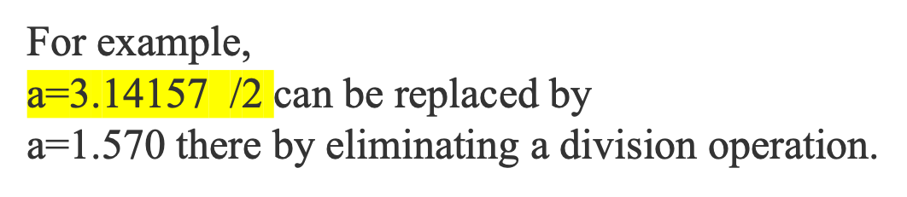
Constant folding
Deducing at compile time that the value of an expression is a constant and using the constant instead is known as constant folding. One advantage of copy propagation is that it often turns the copy statement into dead code.

Slide 43
    Peephole Optimization
A statement-by-statement code-generations strategy often produces target code that contains redundant instructions and suboptimal constructs.
The quality of such target code can be improved by applying “optimizing” transformations to the target program.
The peephole is a small, moving window on the target program.
It is characteristic of peephole optimization that each improvement may spawn opportunities for additional improvements.

Slide 44
    Characteristics of peephole optimizations
Redundant-instructions elimination
Flow-of-control optimizations
Algebraic simplifications
Use of machine idioms
Unreachable or dead code elimination

Slide 45
    Flows-Of-Control Optimizations
The unnecessary jumps can be eliminated in either the intermediate code or the target code by the following types of peephole optimizations. We can replace the jump sequence
goto L1
….
L1: gotoL2 (d)
by the sequence
goto L2
….
L1: goto L2
If there are now no jumps to L1, then it may be possible to eliminate the statement L1:goto L2 provided it is preceded by an unconditional jump

Slide 46
    Redundant Loads And Stores
If we see the instructions sequence
(1) LD R0, a ; Load value of 'a' into register R0
(2) ST a, R0 ;
Store value of register R0 back into memory location 'a'
we can delete instructions (2) because whenever (2) is executed. (1) will ensure that the value of a is already in register R0.
If (2) had a label we could not be sure that (1) was always executed immediately before (2) and so we could not remove (2).

Slide 47
    Algebraic Simplifications
There is no end to the amount of algebraic simplification that can be attempted
through peephole optimization.
Only a few algebraic identities occur frequently enough that it is worth
considering implementing them.
For example, statements such as
x := x+0 or
x := x * 1

Slide 48
    Reduction in Strength
Reduction in strength replaces expensive operations by equivalent cheaper ones on the target machine.
Certain machine instructions are considerably cheaper than others and can often be used as special cases of more expensive operators.
Original operation | Replacement
y * 2 | y << 1
y * 4 | y << 2
y * 8 | y << 3

Slide 49
    Use of Machine Idioms
The target machine may have hardware instructions to implement certain specific operations efficiently. For example, some machines have auto-increment and auto-decrement addressing modes. These add or subtract one from an operand before or after using its value.
The use of these modes greatly improves the quality of code
when pushing or popping a stack, as in parameter passing.
These modes can also be used in code for statements like i : =i+1.
i:=i+1 → i++
i:=i-1 → i- -

Slide 50
    DAG representation of Basic Blocks
DAG for a basic block is a directed acyclic graph with the following labels on nodes:
1. Leaves are labeled by unique identifiers, either variable names or constants.
2. Interior nodes are labeled by an operator symbol.
3. Nodes are also optionally given a sequence of identifiers for labels to store the computed values.

Slide 51
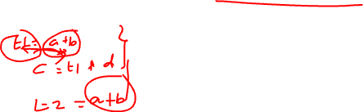
    DAG representation of Basic Blocks(contd)
• DAGs are useful data structures for implementing transformations on basic blocks.
• It gives a picture of how the value computed by a statement is used in subsequent statements.
• It provides a good way of determining common sub - expressions.

Slide 52
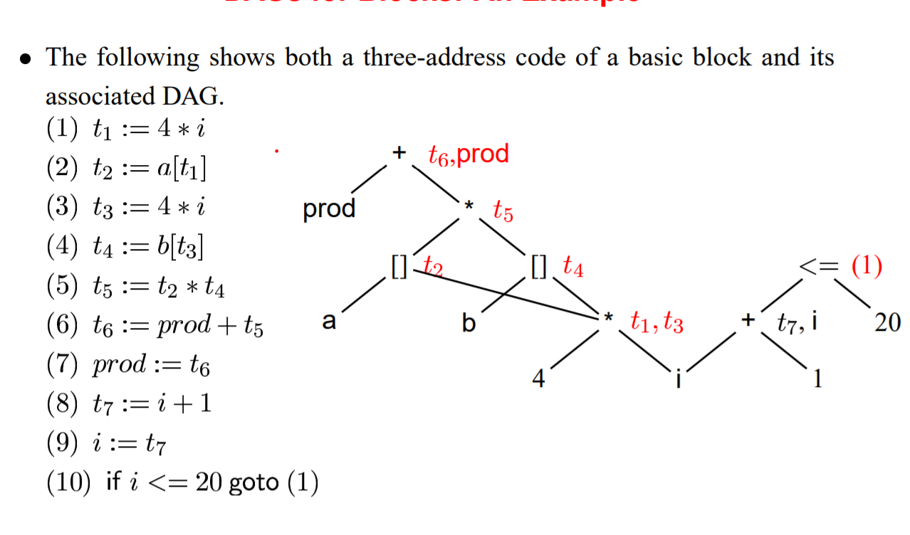
DAG for Blocks – An Example

Slide 53
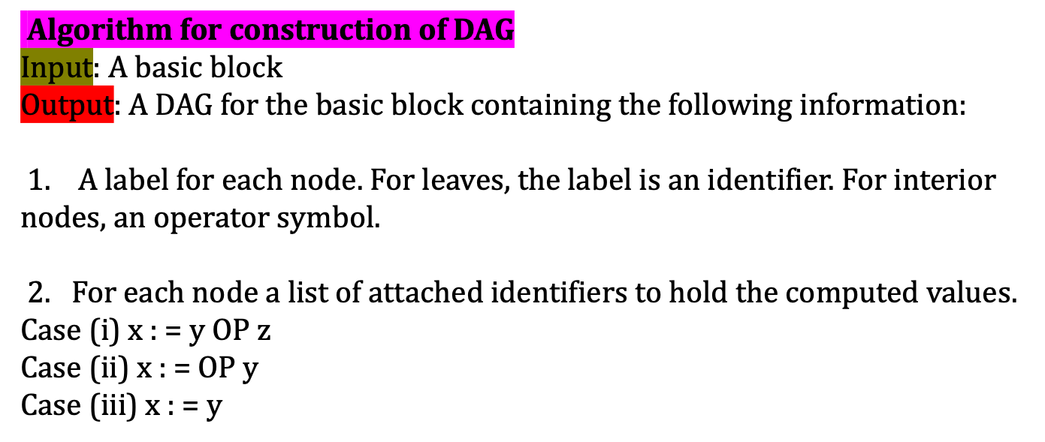
    Algorithm for DAG Construction

Slide 54
    Algorithm for DAG Construction(contd)
Method:
Step 1:
If y is undefined then create node(y).
If z is undefined, create node(z) for case(i).
Step 2:
For the case(i), create a node(OP) whose left child is node(y) and right child is node(z). (Checking for common sub expression). Let n be this node.
For case(ii), determine whether there is node(OP) with one child node(y). If not create such a node.
For case(iii), node n will be node(y).
Step 3:
Delete x from the list of identifiers for node(x). Append x to the list of attached identifiers for the node n found in step 2 and set node(x) to n.

Slide 55
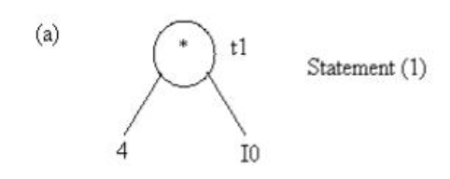
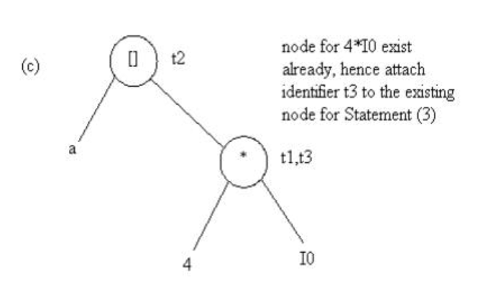
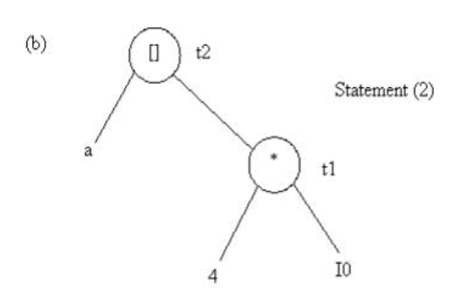
    Stages in DAG Construction
(1) t1 = 4 * 10
t3 = 4 * 10
t2 = a + t1

Slide 56
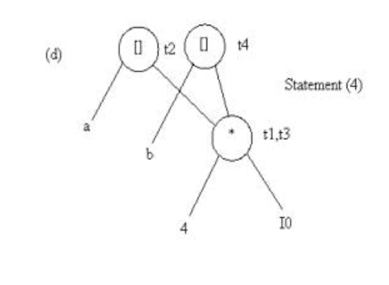
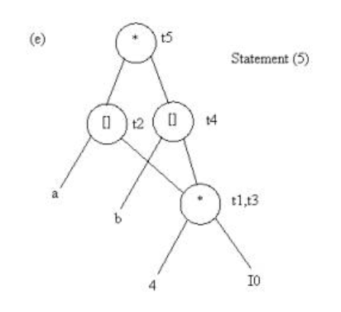
    Stages in DAG Construction(contd)
t4 = b [t3]
t5 = t2 * t4

Slide 57
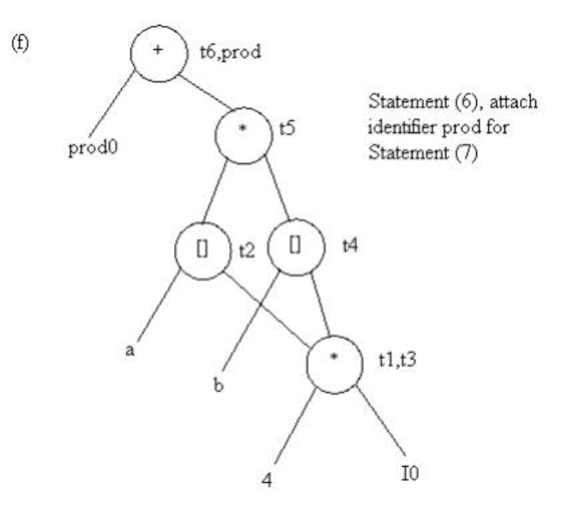
    Stages in DAG Construction(contd)
Summary:
Labels are the names (identifiers) given to the result of a node, and a node can have one or many labels if the same value is known by different names.
t6 = prod0 + t5

Slide 58
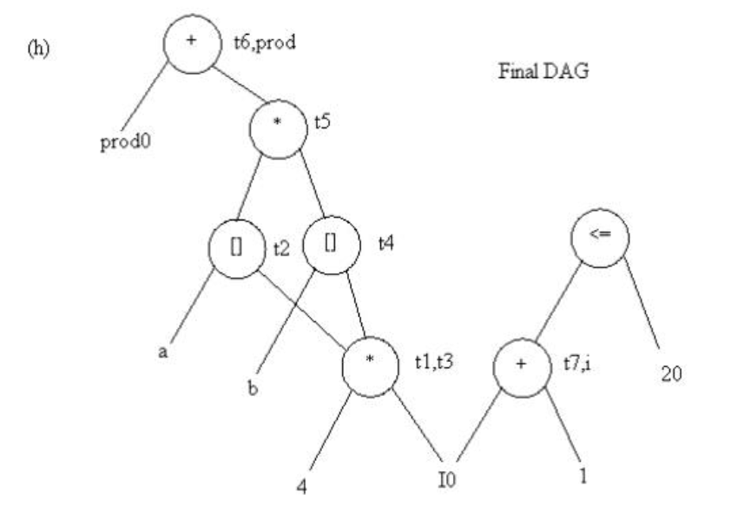
    Stages in DAG Construction(contd)

Slide 59
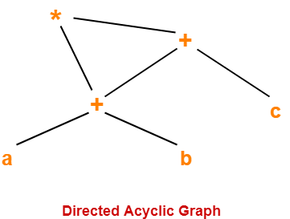
    Example: DAG Construction
Consider the following expression and construct a DAG for it-
( a + b ) x ( a + b + c )
Three Address Code for the given expression is-
T1 = a + b
T2 = T1 + c
T3 = T1 x T2
Now, Directed Acyclic Graph is-

Slide 60
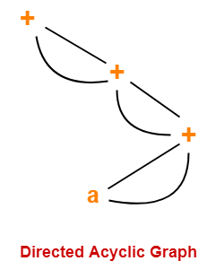
    Example: DAG Construction (contd)
Consider the following expression and construct a DAG for it-
( ( ( a + a ) + ( a + a ) ) + ( ( a + a ) + ( a + a ) ) )

Slide 61
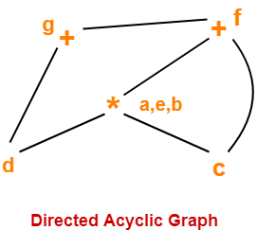
    Example: DAG Construction (contd)
Consider the following block and construct a DAG for it-
(1) a = b x c
(2) d = b
(3) e = d x c
(4) b = e
(5) f = b + c
(6) g = f + d

Slide 62
    Applications of DAG
Application of DAGs:
1. We can automatically detect common sub expressions.
2. We can determine which identifiers have their values used in the block.
3. We can determine which statements compute values that could be used outside the block.

Slide 63
    Optimization of Basic Blocks
There are two types of basic block optimizations. They are :
Structure-Preserving Transformations
Algebraic Transformations

Slide 64
    Structure-Preserving Transformations:
The primary Structure-Preserving Transformation on basic blocks are:
Common sub-expression elimination
Dead code elimination
Renaming of temporary variables
Interchange of two independent adjacent statements.

Slide 65
    Common sub-expression elimination
Common sub expressions need not be computed over and over again. Instead they can be computed once and kept in store from where it’s referenced.
Example:
a: =b+c
b: =a-d
c: =b+c
d: =a-d
The 2nd and 4th statements compute the same expression: b+c and a-d
Basic block can be transformed to
a: = b+c
b: = a-d
c: = a
d: = b

Slide 66
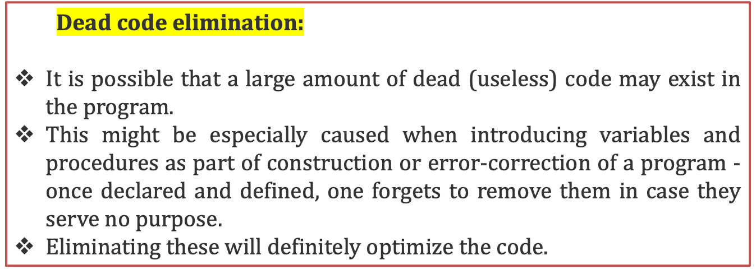
    Dead code elimination

Slide 67
    Renaming of temporary variables
A normal-form block is a transformed version of a basic block in which each distinct computation is assigned to only one temporary variable.
If two temporaries compute the same value, one is replaced by the other, and all its uses are updated.
The purpose is to remove duplicate temporaries and give the block a uniform structure, which makes later optimizations (like common subexpression elimination, copy propagation, and dead-code elimination) easier.
t := b + c
x := t * d
u := b + c
y := u * e can be transformed to:
t := b + c
x := t * d
y := t * e

Slide 68
    Interchange of two independent adjacent statements
Two statements
t1:=b+c
t2:=x+y
can be interchanged or reordered in its computation in the basic block when value of t1 does not affect the value of t2.

Slide 69
    Algebraic Transformations
Algebraic identities represent another important class of optimizations on basic blocks.
This includes simplifying expressions or replacing expensive operation by cheaper ones i.e. reduction in strength.
Another class of related optimizations is constant folding.
Here we evaluate constant expressions at compile time and replace the constant expressions by their values.
Thus the expression 2*3.14 would be replaced by 6.28.
Example:
x:=x+0 can be removed
x:=y**2 can be replaced by a cheaper statement x:=y*y

Slide 70
    Global Dataflow Analysis (contd)
Data-flow information can be collected by setting up and solving systems of equations of the form :
out [S] = gen [S] U ( in [S] - kill [S] )
This equation can be read as “ the information at the end of a statement is either generated within the statement , or enters at the beginning and is not killed as control flows through the statement.”
Such equations are called data-flow equation.

Slide 71
    Points and Paths:
When doing data-flow analysis (like live variables, reaching definitions, available expressions, etc.), we care about the state of variables at specific points in the block.
A point means the position in the program where we analyze the flow of information.
Typically, we consider:
  Before the block begins (before the first statement).
  Between each consecutive statement.
  After the last statement.
S1: a := b + c
S2: d := a - e
S3: f := d * 2
If B1 has 3 assignments, then the points are:
Point 0: before S1 executes.
Point 1: after S1, before S2.
Point 2: after S2, before S3.
Point 3: after S3 (end of block).

Slide 72
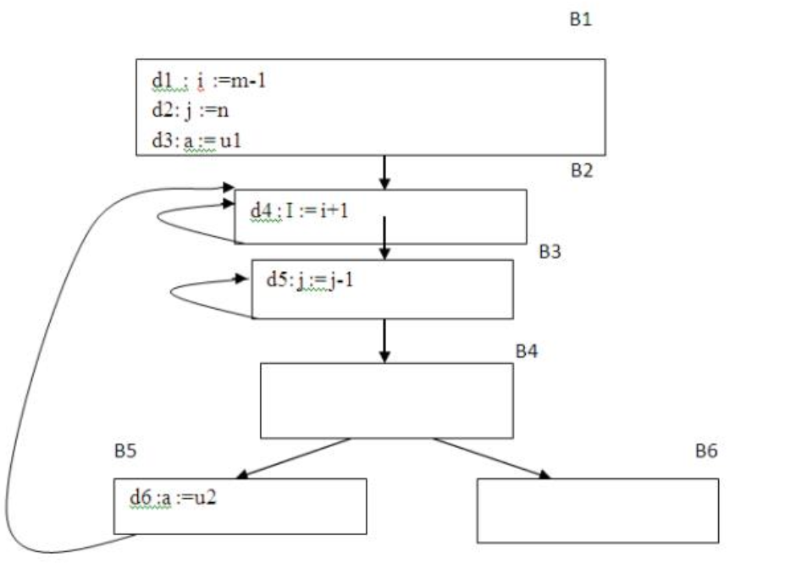
    Points and Paths (contd)
Local view (inside one block)
If a block has n statements, then it has n+1 points.
These points represent the possible “locations” in the program where information about variables can be analyzed (before/after each statement).
Points: before d1, after d1, after d2, after d3.
2. Global view (across blocks)
Now, when we connect all basic blocks into a control flow graph (CFG), we also need to connect their points.A path is defined as a sequence of points that respects both the program order (inside a block) and the control flow (between blocks).

Slide 73
    Points and Paths (contd)
Path definition
A path from 𝑝1​ to pn is a sequence of points such that for every pair (𝑝𝑖,𝑝𝑖+1)
Within a block: If 𝑝i​ is just before a statement, then 𝑝𝑖+1​ must be just after that statement.
Example: In B1, "before d1" → "after d1".
Between blocks: If 𝑝𝑖​ is the end of a block, then 𝑝𝑖+1 ​ is the beginning of one of its successor blocks in the CFG.
Example: End of B1 → Beginning of B2.

Slide 74
    Reaching definitions
In data-flow analysis (especially reaching definitions), a definition of a variable x means:
A program statement that gives x a new value.
Example:
d1: x := y + z → defines x
d2: read(x) → defines x (value comes from input)
These are clear (unambiguous) definitions.

Slide 75
    Reaching definitions
if (a > 10)
x = 5; // definition of x (only if condition true)
If a > 10, then x is defined.
If a <= 10, then x is not defined.
This makes it an ambiguous definition of x.

Slide 76
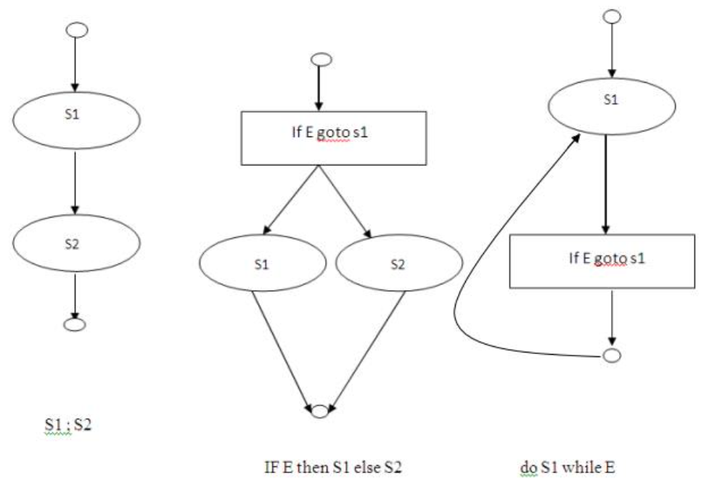
    Some structured control constructs

Slide 77
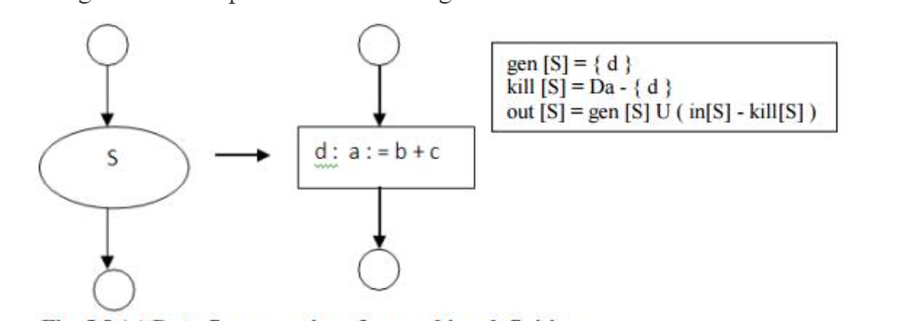
    Data Flow equations - 1
Consider the following data-flow equations for reaching definitions :
Da- set of definitions
in[S] = the set of definitions that may reach the entry of statement
kill[S]These are the definitions that get killed (invalidated) by the statement S.
out[S]: The set of facts that are true after executing block

Slide 78
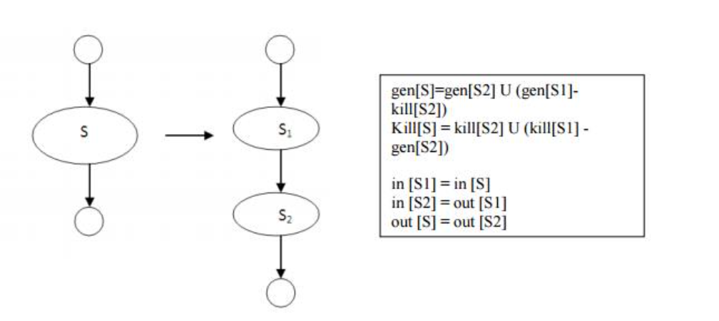
    Data Flow equations - 2
Consider the following data-flow equations for reaching definitions :
Gen(s1)- kill([s2])→the definitions made by S1 that are not destroyed by S2.
Kill[s1]- gen[s2] → those definitions that S1 killed, but S2 later did not regenerate.

Slide 79
    Computation of in and out
The set out[S] is defined similarly for the end of s. it is important to note the distinction between out[S] and gen[S].
The latter is the set of definitions that reach the end of S without following paths outside S.
Out[S] = gen[S] U (in[S] - kill[S])

Slide 80
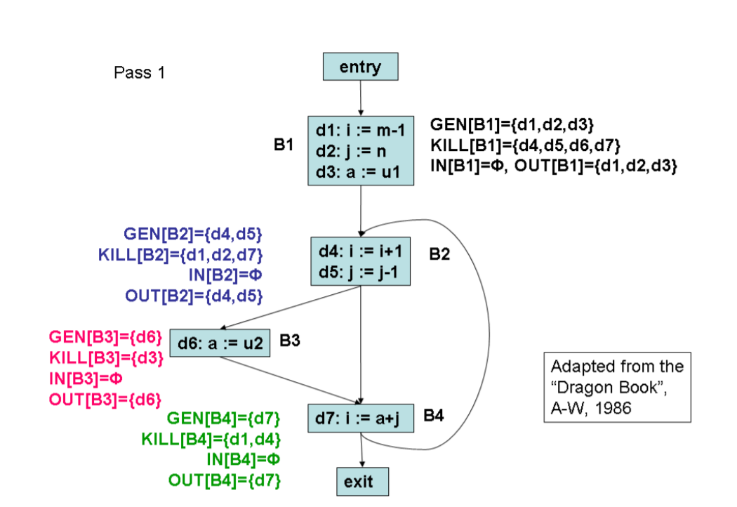
    Example – Data flow Anlaysis

Slide 81
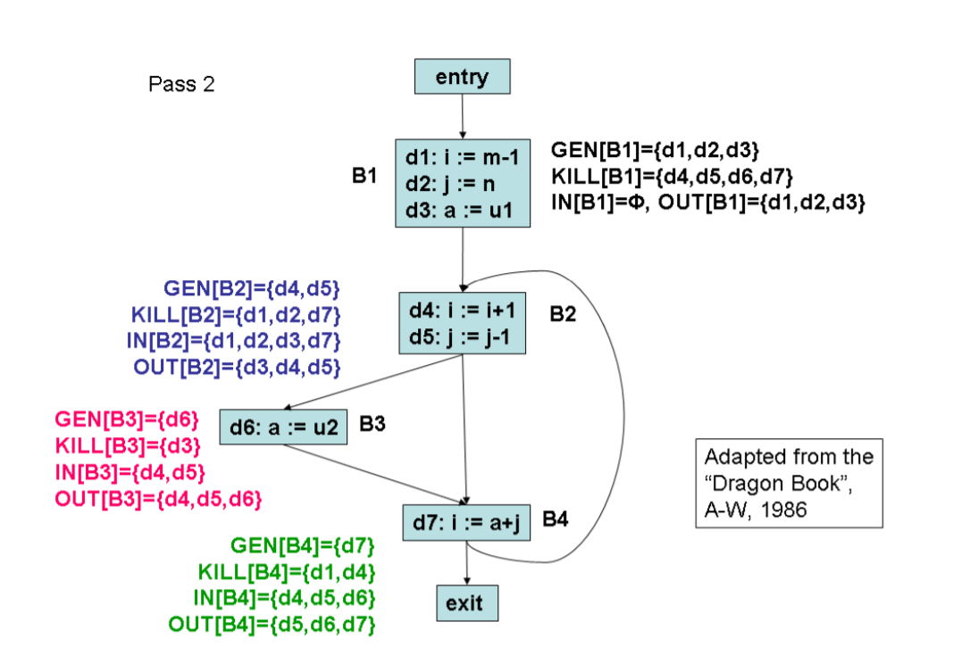
    Example (contd)
We repeat the passes until none of the IN or OUT sets change.

Slide 82
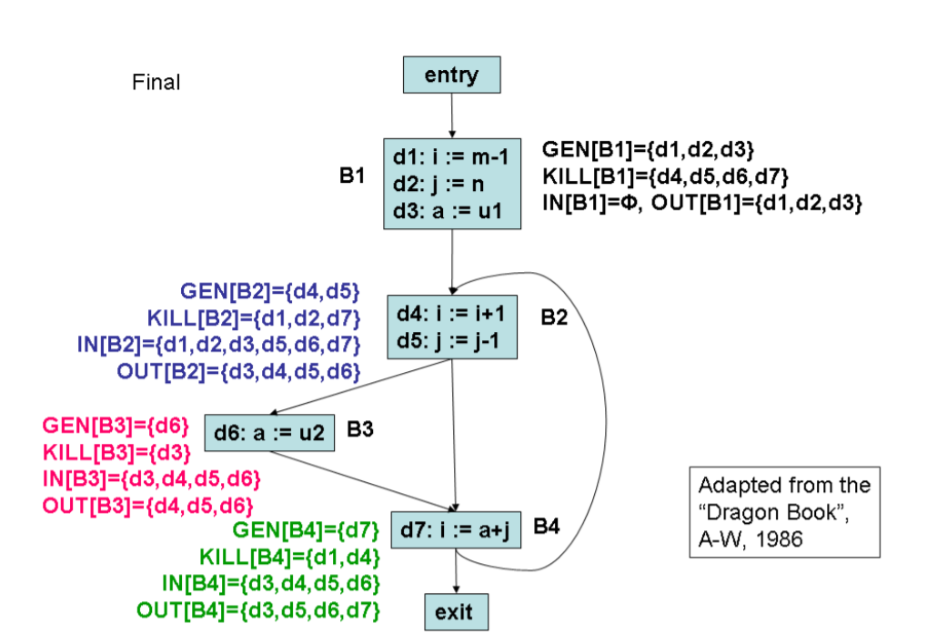
    Example (contd)

Slide 83
Pass | OUT[B1] | OUT[B2] | OUT[B3] | OUT[B4]
1: Initial sets | {d1,d2,d3} | {d4,d5} | {d6} | {d7}
2 | {d1,d2,d3} | {d3,d4,d5} | {d4,d5,d6} | {d3,d5,d6,d7}
3 | {d1,d2,d3} | {d3,d4,d5,d6} | {d4,d5,d6} | {d3,d5,d6,d7}
4 | Same | Same | Same | Same

Slide 84


